Slide 1

Self Driving Cars – The Importance and Significance
IST 736 – Text Mining
Lucas Zarzeczny - Jiang Zhang – Patrick aslakson

Slide 2
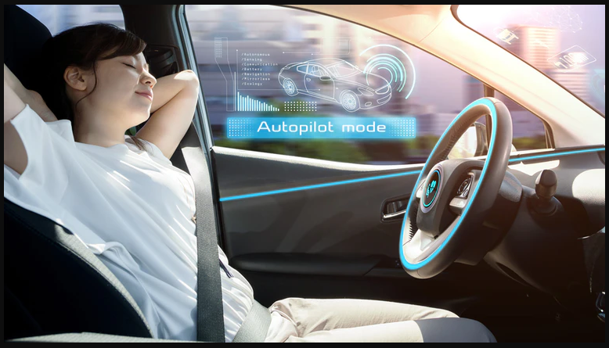
How would you like to take a nap while driving only to wake up to being pulled over?
We wanted to find the public’s answer to this question!

Slide 3
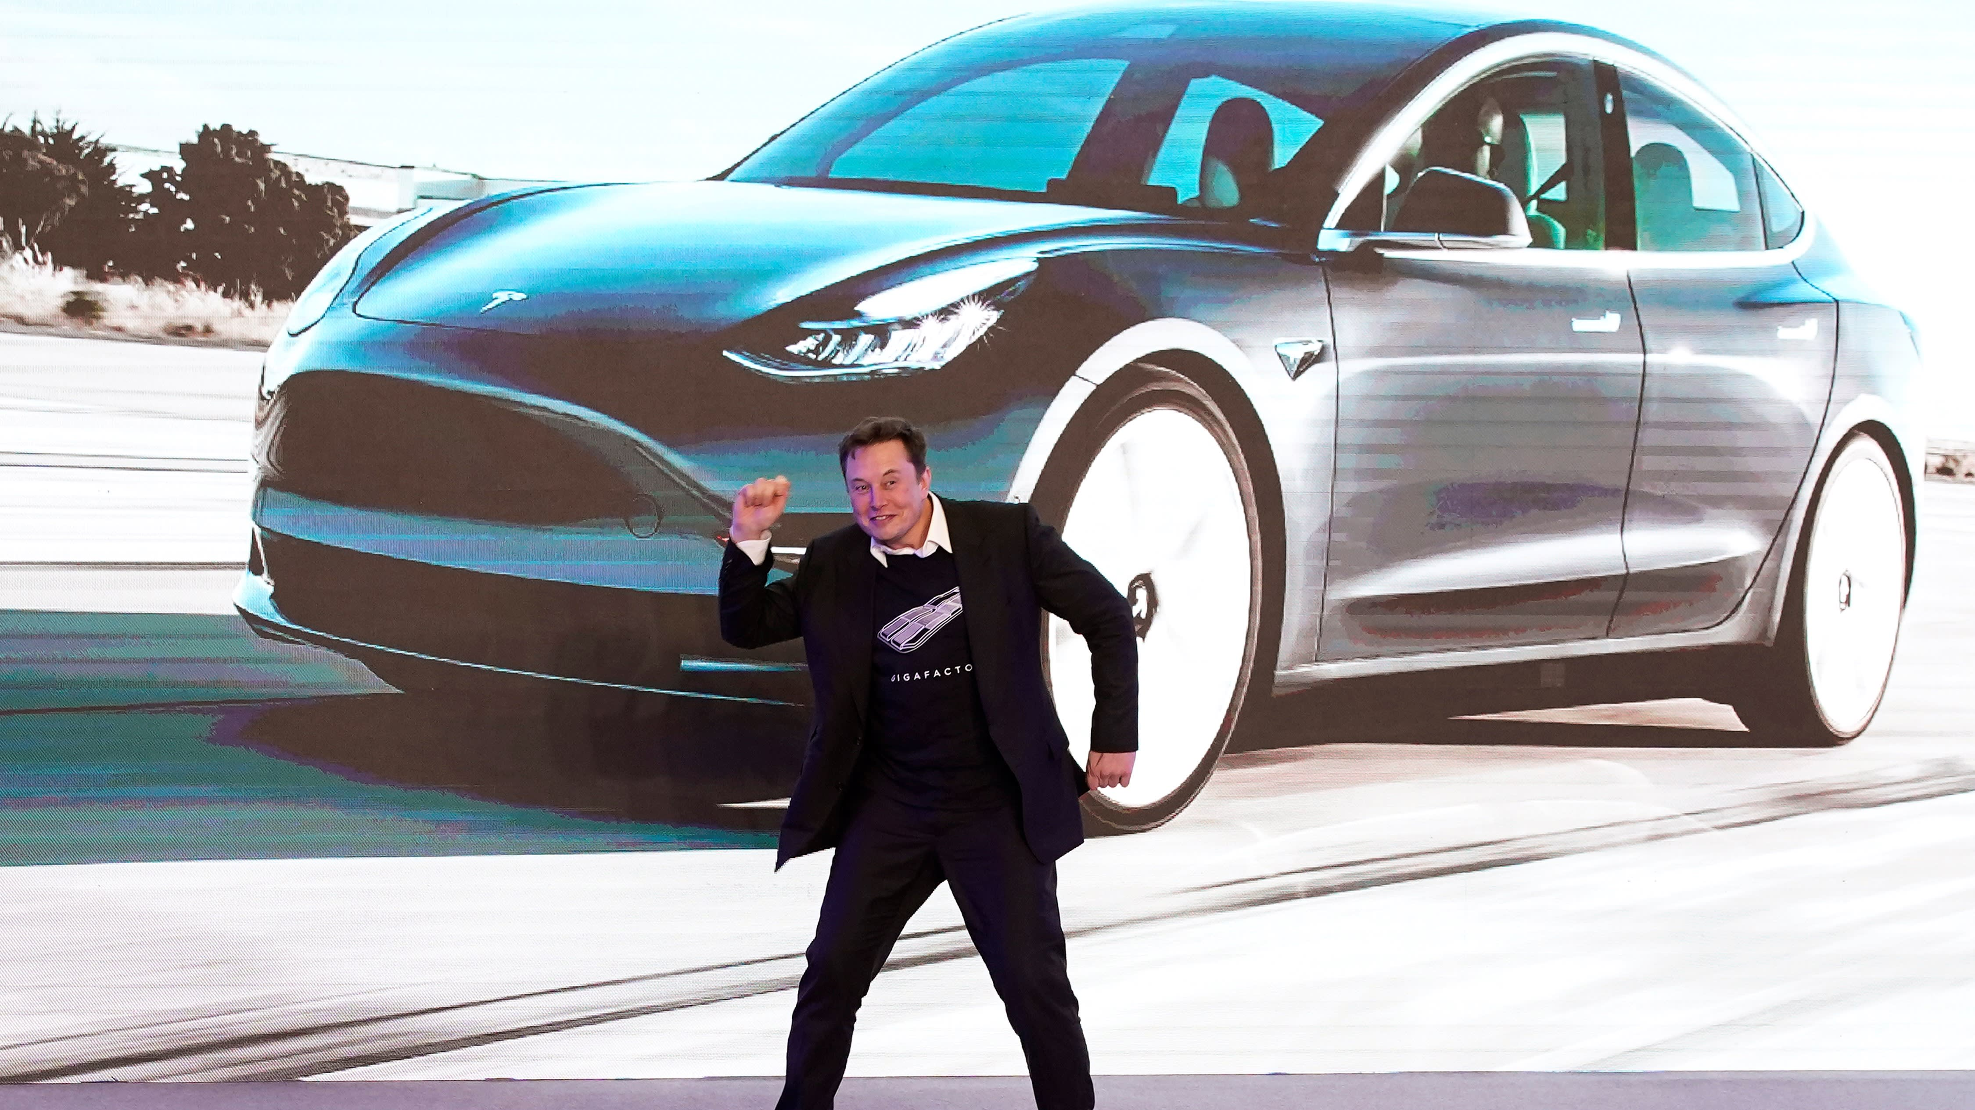
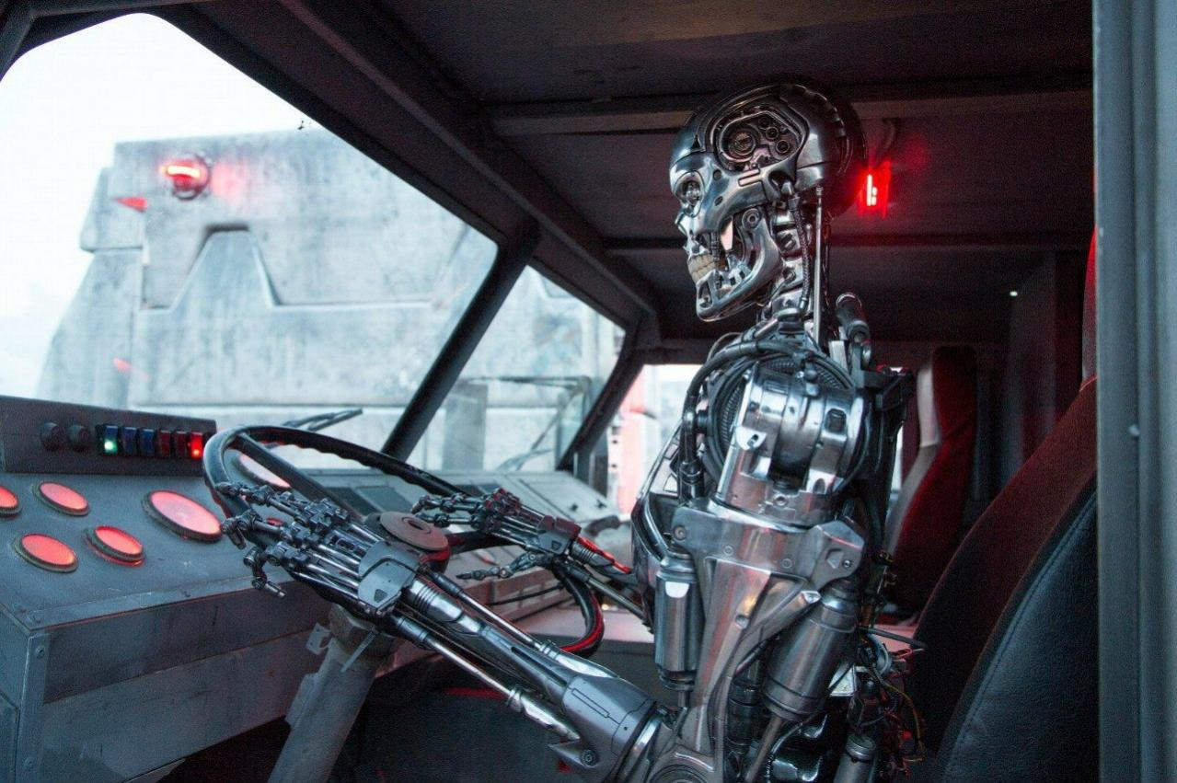
Introduction
Introduction
Autonomous self-driving cars will be a part of the future as we know it.
Public sentiment towards it, as well as artificial intelligence, has always been varied
Can bring great benefits but also dangers
What are current public opinions about about autonomous vehicles on social media and in the news?

Slide 4

ProS versus cons
Pros
Environmentally Cleaner
Potentially Safer – 81% of accidents are due to human error
Reduced Cost - Maintenance, Insurance.
Reduce Traffic Congestion
Faster Travel Speeds
Cons
Cost Prohibitive
Safety Concerns
Possible Loss of Jobs – Taxis
Economic Dependance on Fossil Fuels
Risk of Hacking

Slide 5
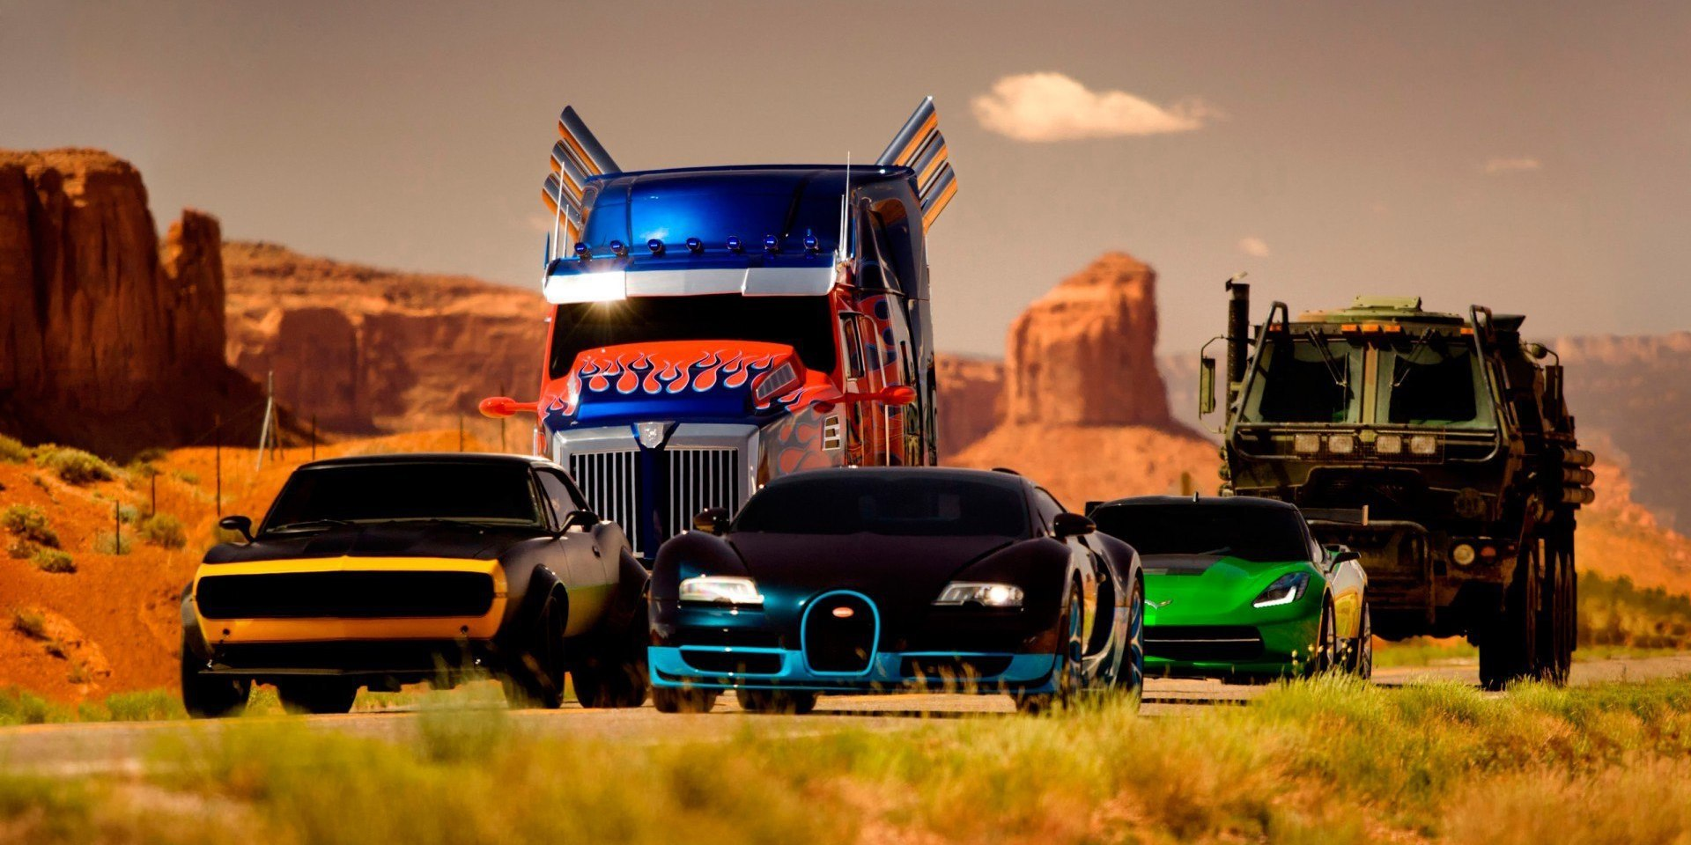
Autonomy
Layers of Autonomy
Different cars are capable of different levels of self-driving and are often described by researcher on a scale of 0-5.
Level 0: All major systems are controlled by humans
Level 1: Certain systems, such as cruise control or automatic braking, may be controlled by the car, one at a time
Level 2: The car offers at least two simultaneous automated functions, like acceleration and steering, but requires humans for safe operation
Level 3: The car can manage all safety-critical functions under certain conditions, but the driver is expected to take over when alerted
Level 4: The car is fully-autonomous in some driving scenarios, though not all
Level 5: The car is completely capable of self-driving in every situation

Slide 6
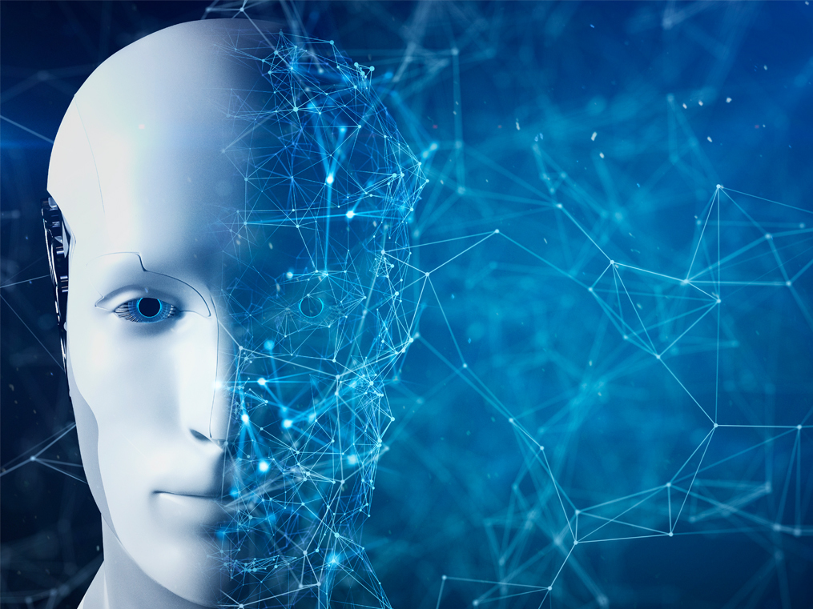
strategy
LDA
Count Vectorizer
TFIDF Vectorizer
Bernoulli Vectorizer
SVM with 4 different kernels
Recurrent Neural Network (LSTM)
Naive Bayes

Slide 7
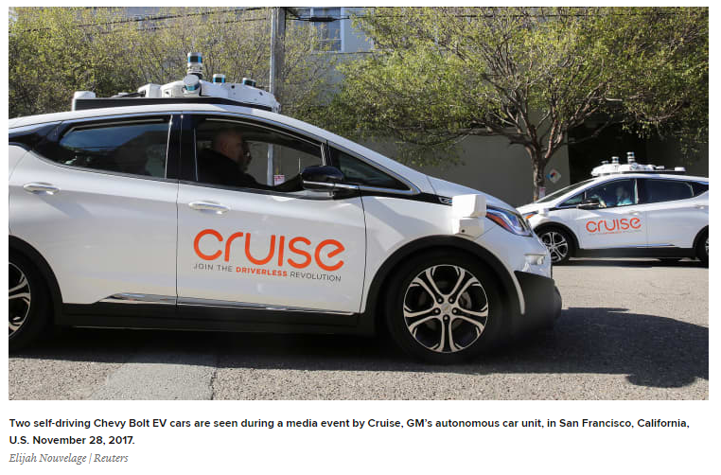
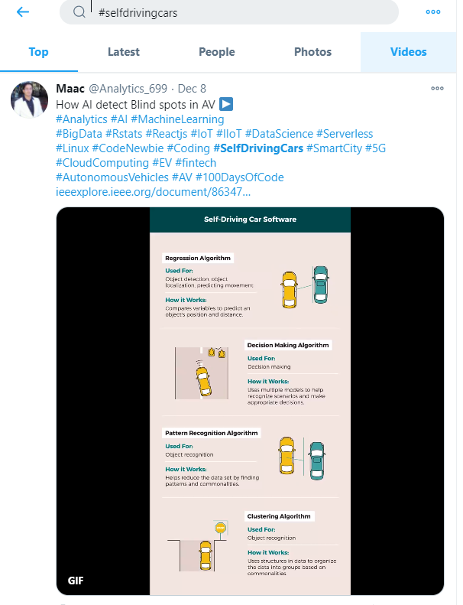
Data
Twitter Hashtags:
#autonomous OR #driverless OR #driverlesscars OR #autonomousvehicles OR #selfdriving OR #selfdrivingcars

Slide 8
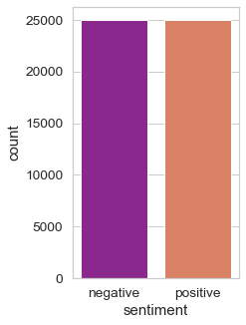
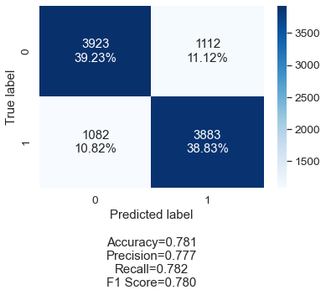
Results
[Movie Dataset Negative and Positive Count]
[Count Vectorizer Confusion Matrix]

Slide 9
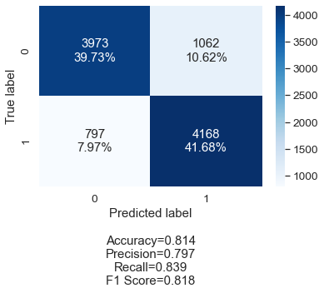
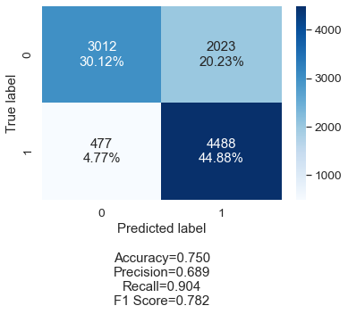
Results
Support Vector Machine Kernel = Linear Confusion Matrix
Support Vector Machine Kernel = Polynomial Confusion Matrix

Slide 10

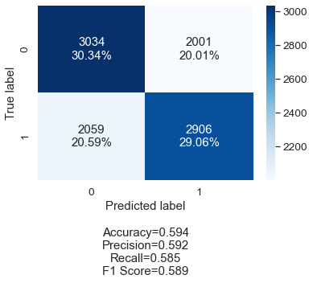
Results
Support Vector Machine Kernel = RBF Confusion Matrix
Support Vector Machine Kernel = Sigmoid Confusion Matrix

Slide 11

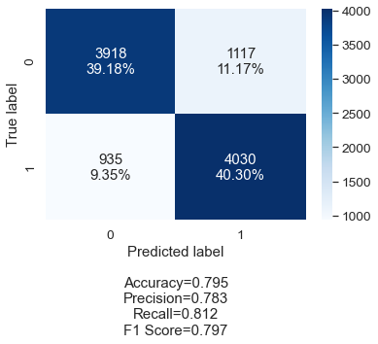
Results
Bernoulli Confusion Matrix
[TFid Confusion Matrix]

Slide 12

Wordcloud

Slide 13
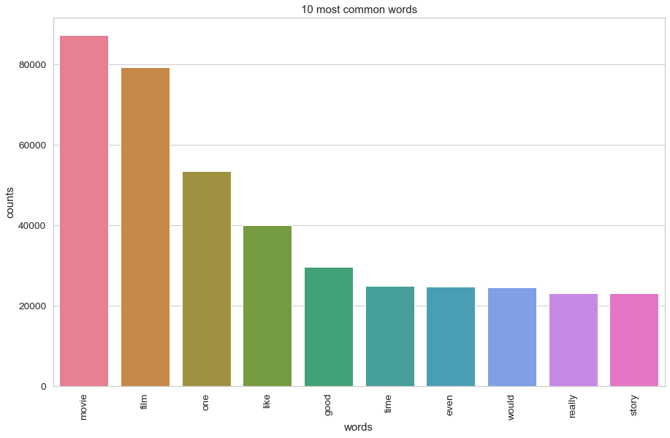
Most common words

Slide 14
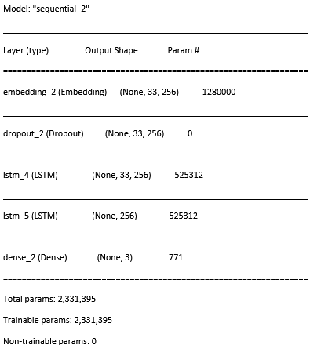
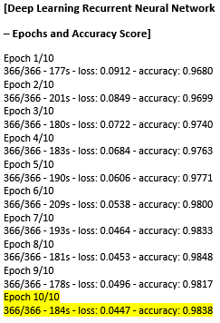
Deep learning
Deep Learning Recurrent Neural Network – LSTM – Model Summary
Deep Learning Recurrent Neural Network
– Epochs and Accuracy Score

Slide 15
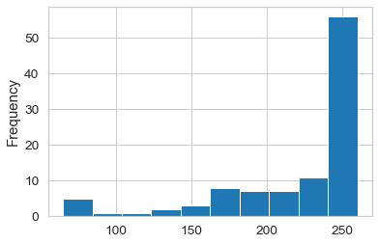
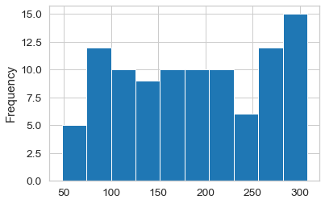
Deep Learning Recurrent Neural Network – News Data and Twitter Results
News
Twitter
Positive | 56
Neutral | 22
Negative | 23
Overall | Positive
Positive | 54
Neutral | 22
Negative | 23
Overall | Positive

Slide 16
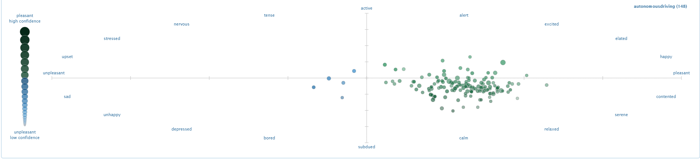
Other ways to analyze sentiment

Slide 17
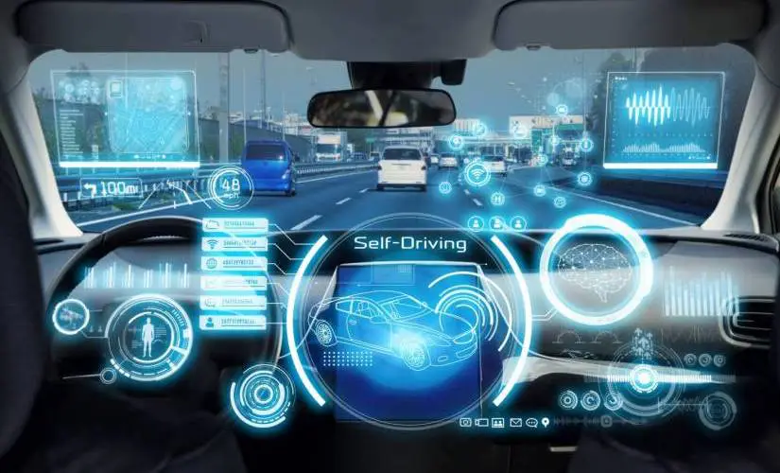
Conclusion
Self-driving cars are heavily reliant on AI and Deep Learning to respond properly to the road
Tremendous amount of training data needed
Rarer situations such as specific types of debris or car accidents may be insufficient in training data
Recent Gallup poll shows about 50% of Americans would not use technology, which is a different statistic than just sentiment towards the technology itself

Slide 18
Websites
www.autobytel.com
www.nhtsa.gov
www.Twitter.com
www.ucsusa.org/resources/self-driving-cars-101

